Slide 1
Sample Rate Selection
  Trade-offs
  Absolute lower bound
  Smoothness
  Delay
  Disturbances
  Quantization
  Anti-aliasing filters
  Other Topics of Interest . . .

Slide 2
Sample Rate Selection Trade Offs
Advantages
Disadvantages
better performance (faster response, lower overshoot, . . .)
cost
Faster
Sampling
less sensitive to word length limitations
less costly
lower performance
Slower
Sampling
For mass produced systems: general rule of thumb is to design to sample as slow as possible such that performance specifications can be met.
For one-of-a-kind or few-of-a-kind systems (e.g., satellites): sample faster to simplify control design because labor costs are significant portions of overall costs.

Slide 3
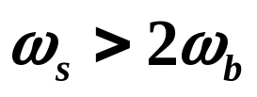
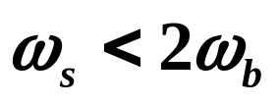

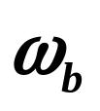
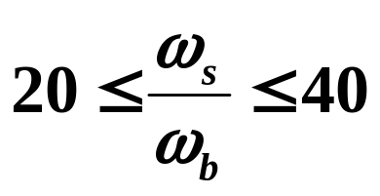
Absolute Lower Bound
The absolute lower bound on possible sample rates is dictated by the sampling theorem:
If , then sampling will cause aliasing of signals near bandwidth frequency to lower frequencies.
In state-space designs where overall closed-loop poles are those of controller and estimator poles, estimator poles usually are faster than controller poles. So is dictated largely by controller poles.
Typically:
If ratio lower than 20, it may cause unsmooth responses and slower rise times.

Slide 4
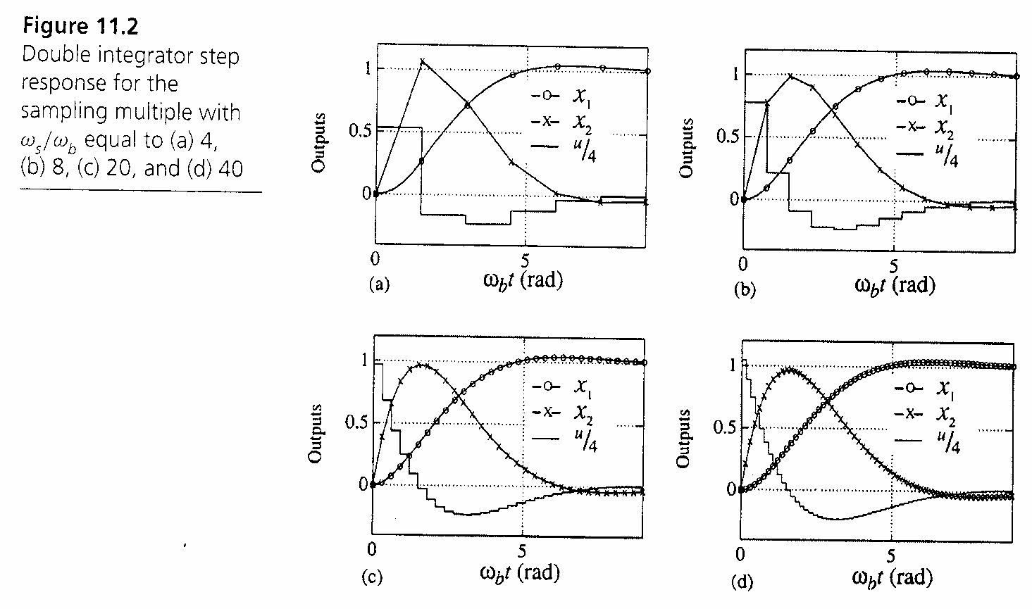

Sample rate selection affects smoothness of responses:
For reasonably
smooth responses,
need ω_{s} /ω_{b} 20.

Slide 5


Reducing the sampling rate can also cause a delay
up to one period in the response of the system.
+
A/D
D(z)
D/A
G(s)
-

Slide 6
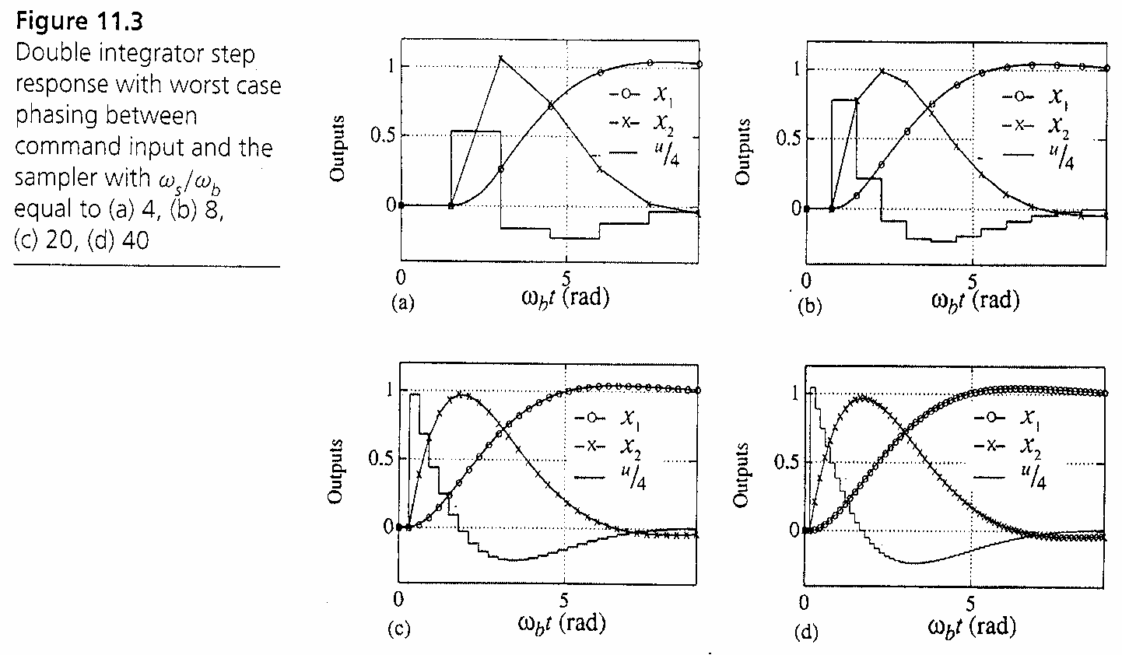
Example 11.2 of Text

Slide 7
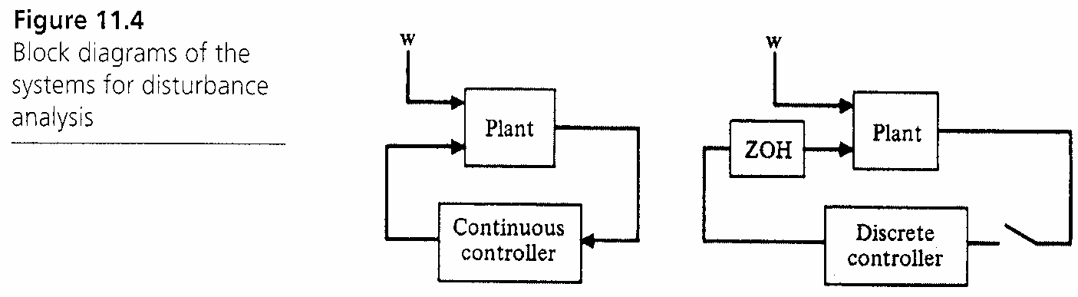
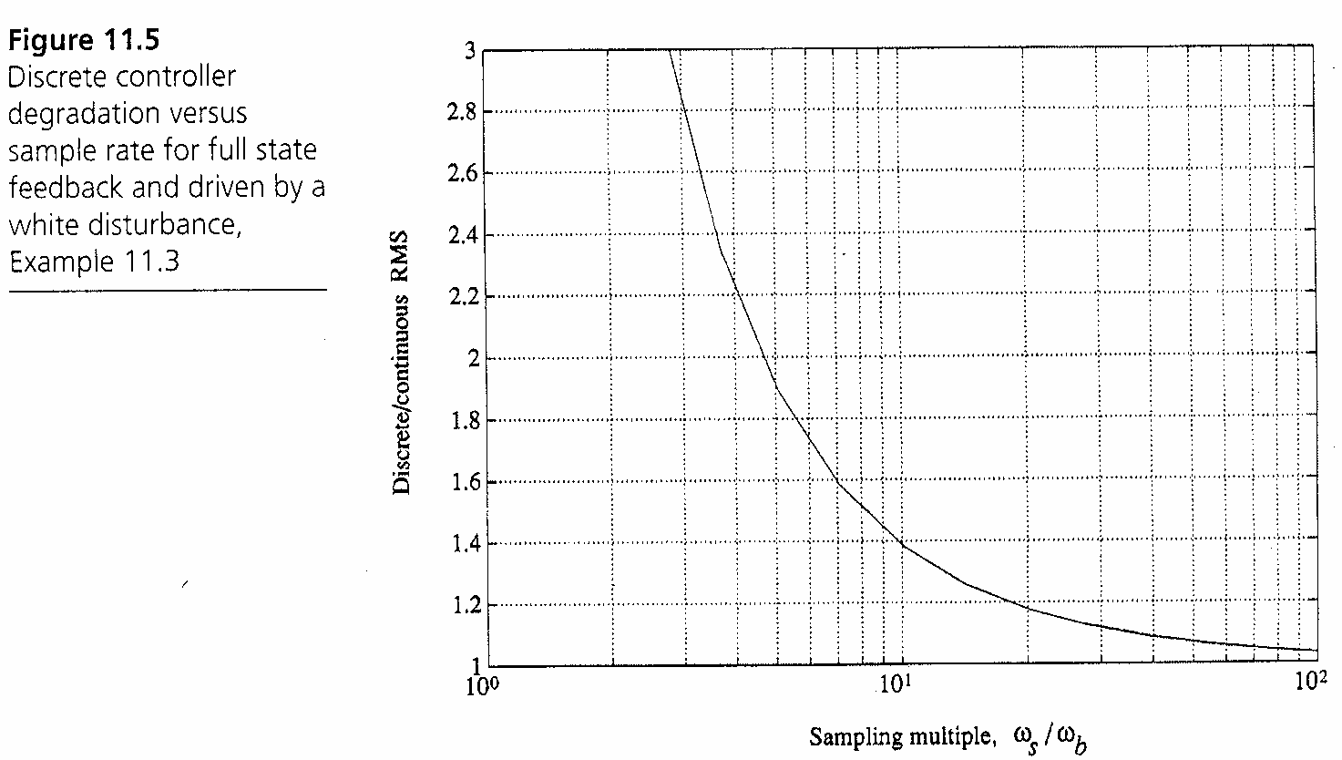
Effects of ω_{s} and Disturbances

Slide 8

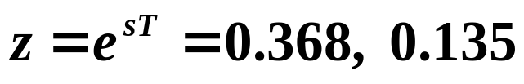


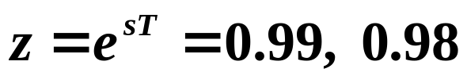
Sample Rate Effects and Quantization
For slower ω_{s} , poles generally are more spread out.
Im(s)
Im(z)
Re(s)
Re(z)
1
For faster ω_{s} , poles move to the right and are more
bunched together (near z = 1).
Im(z)
Re(z)
1

Slide 9




Some Rules of Thumb on Sample Rate Effects from Quantization
Generally, if the word size is bits, sampling faster does not cause problems. is not affected by word size in both cascade and parallel realizations.
If the word size is bits, sampling faster usually causes problems. Increasing increases the variance in states.
If , the effects depend on pole locations and the implementation (cascade, parallel, direct realization). Cascade and parallel implementations of lower-order transfer functions are always better numerically than direct realizations of a higher-order controller.

Slide 10
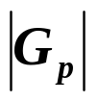
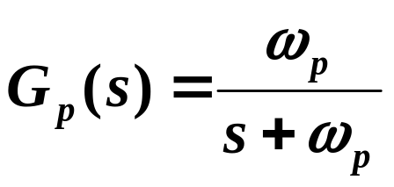

Measurement Noise and Anti-Aliasing Filters
Anti-aliasing filters are generally needed to remove
high-frequency noise in sensor measurements.
Anti-aliasing filter is a low-pass filter:

Slide 11
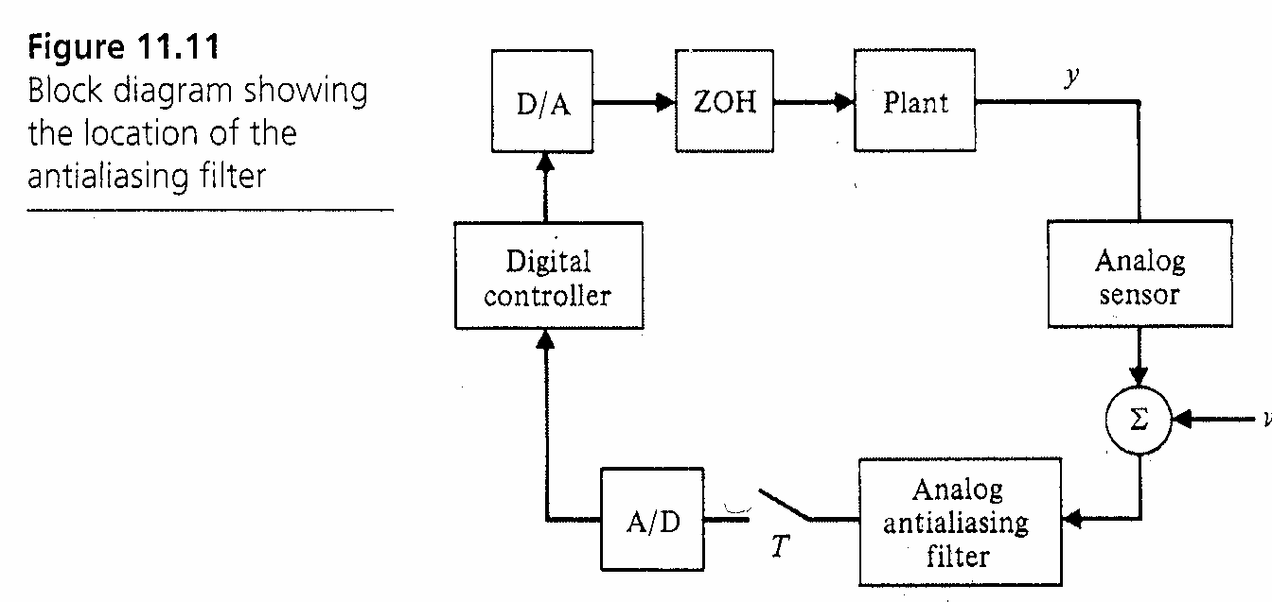

Slide 12
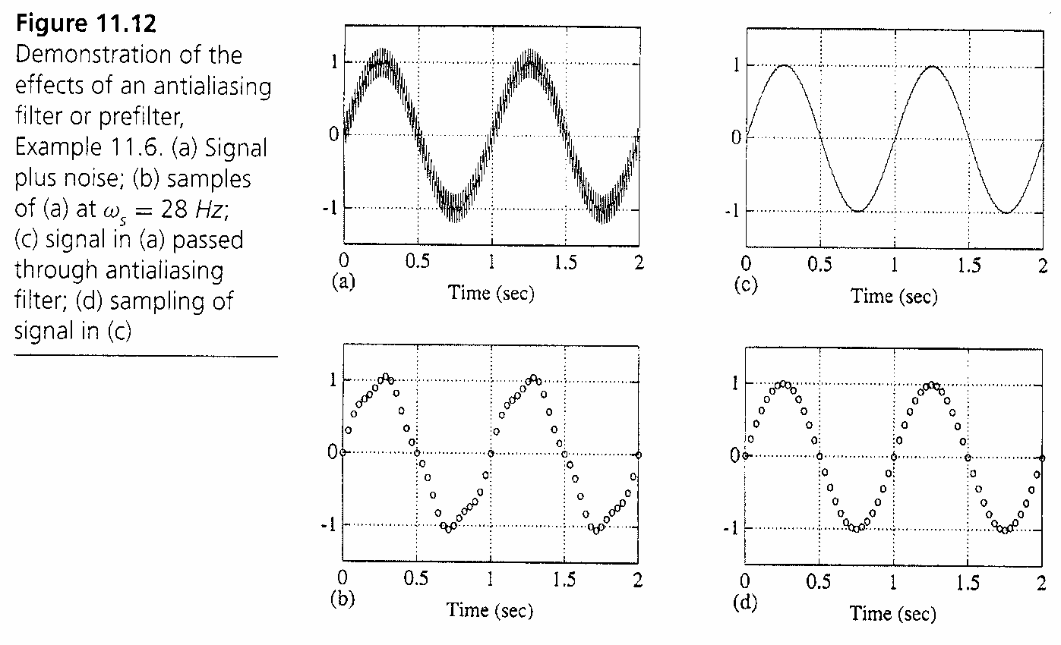
Effect of Anti-Aliasing Filter on Sample Rate Selection
Example 11.6 of Text

Slide 13
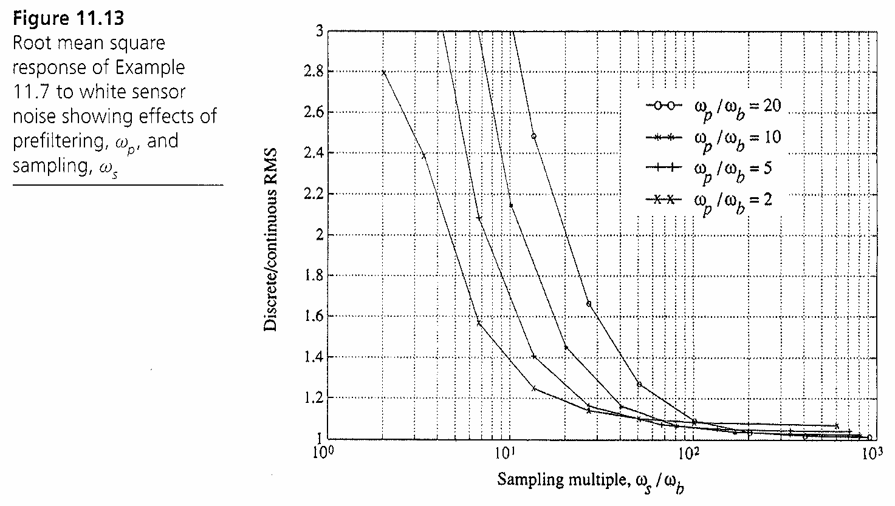
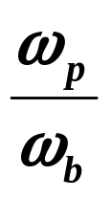

In general, as and/or (but > 2 or so)
less sensitivity of system to sensor noise

Slide 14
Other Sample Rate Selection Topics
Effects of resonances (Section 11.3)
Sensitivity to parameter variations (Section 11.4)
Multi-rate sampling (Section 11.6)

Slide 15
Other Control System Topics of Interest (1/3)
Robust Control (we briefly discussed at the level of Section 7.4.2, ECEN 50x8 covers in detail)
    Robust and optimal control, K Zhou, JC Doyle, and K Glover, Prentice Hall, 1996
    Essentials of robust control, K Zhou and JC Doyle, Prentice Hall, 1998
Controllability, Observability, and other linear systems analysis concepts (ECEN 5448 covers in detail)
    Linear Systems, T Kailath, Prentice Hall, 1980
    Linear System Theory and Design, CT Chen, Oxford University Press, 1999

Slide 16
Other Control System Topics of Interest (2/3)
Optimal control (Chapter 9 introduces, ECEN 5358 covers in detail)
    Calculus of Variations and Optimal Control Theory: A Concise Introduction, D Liberzon, Princeton University Press, 2012
Multi-variable control (Chapter 9 introduces, ECEN 5418 covers in detail)
    Linear Systems, T Kailath, Prentice Hall, 1980
    Linear Systems Theory, JP Hespanha, Princeton University Press, 2009

Slide 17
Other Control System Topics of Interest (3/3)
System identification (Chapter 12 introduces, ASEN 6xxx covers in detail)
    System Identification: Theory for the User, L Ljung, Prentice Hall, 2nd Edition, 1999
Nonlinear systems and control (Chapter 13 introduces, ECEN 7438 covers in detail)
    Nonlinear Systems, HK Khalil, Prentice Hall, 3rd Edition, 2002
    Applied Nonlinear Control, JE Slotine and W Li, Prentice Hall, 1991

